Slide 1



Time’s Asymmetry in Counterfactuals
Dominic Le
Work in Collaboration with Ioana Grosu and Patricia Ganea
@ the Language and Learning Lab
University of Toronto
Confluence 2025

Slide 2
Firstly to motivate the research question we’ll discuss the following topics:
Definition of counterfactuals as conditionals.
Distinction between forward and backward counterfactual constructions.
Operationalizing causal reasoning as functional graphs.
Psychological literature comparing theories in counterfactual reasoning.

Slide 3
Imagine this Real Course of Events:
I was cooking breakfast
You might wonder: “Why did my smoke detector sound?”😅
My smoke detector sounded

Slide 4
Imagine this Real Course of Events:
I was cooking breakfast
Then, consider: “Did burning the eggs cause the smoke detector to sound?” 🤔
I burnt the eggs
My smoke detector sounded

Slide 5
Counterfactuals (CFs)
I was cooking breakfast
Definition: a hypothetical situation that includes some false premise that diverges from the actual course of events
E.g. “What if I didn’t burn the eggs”
Process: evaluate the correctness of query events given the counterfactual premise (CF conditional).
Purpose: to understand the underlying causal mechanism behind events (i.e generate explanations and assign credit, Lucas and Kemp, 2015).
I burnt the eggs
I didn’t burn the eggs (CF premise)
My smoke detector sounded
Whether the smoke detector sounded
( CF query)

Slide 6
Direction in Time (Broadbent, 2007)
Forwards
Premise occurs before the query
E.g “If my smoke detector had not sounded, my neighbors would not have heard it”
Whether my smoke detector sounded
Whether my neighbors heard
I burnt the eggs

Slide 7
Direction in Time (Broadbent, 2007)
Forwards
Premise occurs before the query
E.g “If my smoke detector had not sounded, my neighbors would not have heard it.”
Diagnoses sufficient causation
Backwards
Query occurs before the premise
E.g “If my smoke detector had not sounded, the toast would not have burnt.”
Diagnoses necessary causation
Whether I burnt the toast
Whether my smoke detector sounded
Whether my neighbors heard
(Causal Disjunction)
I burnt the eggs

Slide 8

Reasoning Possible Worlds (Stalnaker, 1981; Lewis, 1979)
🍳
🍳
🔥
🚨
🍞
🍞
Actual world: I was cooking eggs and toast, I burnt the eggs, and then the fire alarm sounded!
Counterfactual: If the egg did not burn, would the fire alarm have sounded?

Slide 9
Reasoning Possible Worlds
🍳
🍳
🍳
🔥
🚨
🚨
🔥
🍞
🍞
🍞
Humans preserve minimality when reasoning forward counterfactuals (Kahneman and Tversky, 1982)

Slide 10
Formalizing Causal Reasoning as Functional Graphs (Danks, 2014)
Events (X) are nodes variable between present or absent (1 or 0)
Links (->) denote directional causal dependencies (as functions!)
I burnt the toast (B)
(Causal Conjunction)
Smoke detector sounded (S)
I replaced the batteries in the detector (R)
^ New* what really happened

Slide 11
Formalizing Causal Reasoning as Functional Graphs (Danks, 2014)
Events (X) are nodes variable between present or absent (1 or 0)
Links (->) denote directional causal dependencies (as functions!)
I burnt the toast (B)
(Causal Conjunction)
Smoke detector sounded (S)
I replaced the batteries in the detector (R)
Prompt: If the alarm had not sounded (S0), would the toast have been burnt (B#)?

Slide 12
Minimal Networks Theory (Hiddleston, 2005)
Represent the situation as a functional graph
Actual Model
Prompt:
If the alarm had not sounded (S0), would the toast have been burnt (B#)?
B 1
R 1
S = B, when R = 1
S = R, when B = 1
S 1
^ What really happened (in symbol form)

Slide 13
Minimal Networks Theory (Hiddleston, 2005)
Represent the situation as a functional graph
Generate Possible Worlds
Possible Worlds
B 1
R 0
Actual Model
Prompt:
If the alarm had not sounded (S0), would the toast have been burnt (B#)?
B 1
R 1
B 0
R 0
S 0
S = B, when R = 1
S = R, when B = 1
S 1
R 1
S 0
B 0
^ What really happened (in symbol form)
S 0

Slide 14
Minimal Networks Theory (Hiddleston, 2005)
Represent the situation as a functional graph
Generate Possible Worlds
Pick minimal world or N/A
Possible Worlds
B 1
R 0
Actual Model
Prompt:
If the alarm had not sounded (S0), would the toast have been burnt (B#)?
B 1
R 1
B 0
R 0
S 0
S = B, when R = 1
S = R, when B = 1
S 1
R 1
S 0
B 0
There are two minimally different worlds ->
S 0

Slide 15
Previous Psychological Data
Participants’ mean “yes” responses were at chance, 55.3 ± 7.2 % per 1 SD (Rips, 2010).
So Rips theorized that people sample between the two models.
Lucas and Kemp (2015) compared their model that guessed between the two Minimal Worlds in a similar conjunction, and found above chance “yes” (p < .001).
Regardless, this type of question framing does not explain which mental model participant utilize.
Minimal Worlds
B 1
R 0
Prompt:
If the alarm had not sounded (S0), would the toast have been burnt (B#)?
S 0
B 0
R 1
S 0
Two minimally contradicting worlds ->

Slide 16
Problem with State Query in Minimal Networks
The state of B (=0; =1) in both minimal worlds contradict each other.
Possible Worlds
B 1
R 0
B 0
R 1
S 0
S 0
Minimal Worlds
B 0
R 0
S 0

Slide 17
Problem with State Query in Minimal Networks
The state of B (=0; =1) in both minimal worlds contradict each other.
There are multiple worlds where B=0, including non-minimal worlds.
Possible Worlds
B 1
R 0
B 0
R 1
S 0
S 0
Minimal Worlds
B 0
R 0
S 0

Slide 18
Problem with State Query in Minimal Networks
The state of B (=0; =1) in both minimal worlds contradict each other.
There are multiple worlds where B=0, including non-minimal worlds.
Whether people believe B=0, does not indicate whether they have a preference for the minimal worlds, which is the central to forward CFs.
Possible Worlds
B 1
R 0
B 0
R 1
S 0
S 0
Minimal Worlds
B 0
R 0
S 0

Slide 19
Research Question
How does minimality differs in backwards counterfactuals in regards to mental models?
Why?
This may give us a deeper understanding what draws people to diagnose backwards CFs.
Notes:
Does the past differ in the future in how open they are?

Slide 20




Methods
All possible configurations of single-cause system:
Materials: Blicket Detector Machine,
Design: 3 x 2 repeated-measures
System conditions:
Disjunction
Conjunction
Single-cause with Inert
Direction conditions:
Forward
Backwards
Procedure: In random order, participants learned about each different causal system, similarly to Nyhout and Ganea (2019).
In each case, they answered control questions, e,g, “the blue block goes on the box, what does the light look?”
Across CF test trials, we prompted a forced-choice response between a minimal or a non-minimal world configuration.
(Design and Collection in Collaboration with Ioana Gorus and Patricia Ganea at the Language and Learning Lab at OISE)

Slide 21
Test Trial Sequence Example (Single-cause)
“If the light had been off, what would the blocks have likely looked like?”
B 0
O 0
B 1
O 1
B 0
O 1
B 0
O 0
L 0
L 1
L 0
L 0

Slide 22
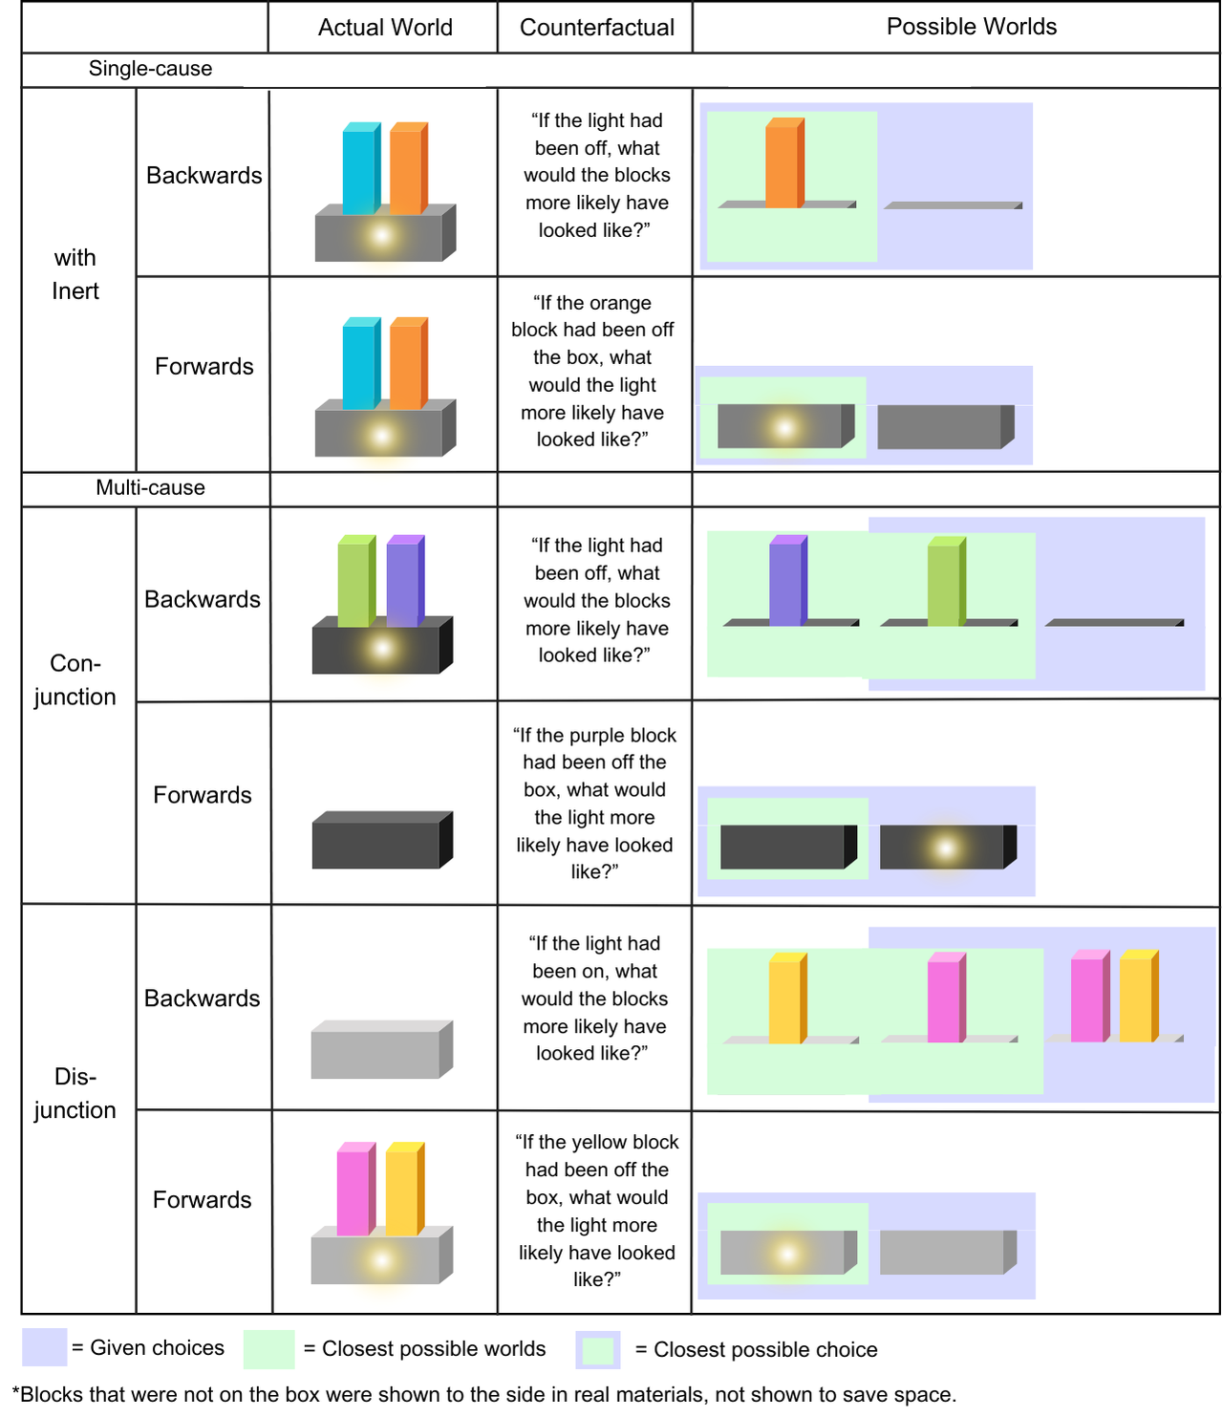

Slide 23
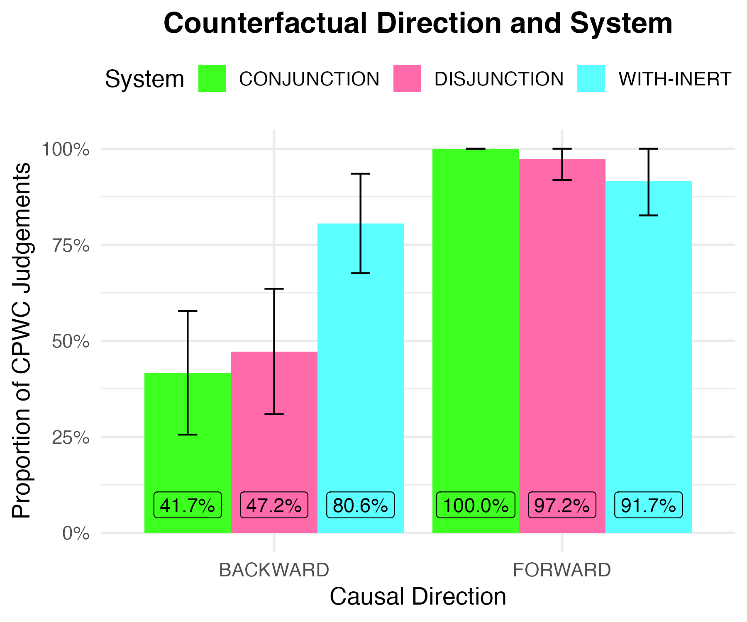
Results
Participants: 46 adult English speakers from the U.S via Amazon Mechanical Turk, excluded 10 from analysis failing control questions.
In both multi-cause, backward conditions, participants’ preference for the minimal world did not differ from chance (p = 1.0).
In the single-cause, backward condition, participants’ preference was significantly above chance (p<.001)
Responses across forward conditions were all at ceiling for minimal world answers.

Slide 24
Discussion & Conclusions
Interpretation of Findings:
Potential task effects
Evidence for necessary/sufficient causation
Limitations:
Low sample size
Lack of pre-existing data of backward CFs
Lack of existing data on this methodology
Lack of Scenarios
Future Directions:
Ordering effects
Causal Powers
Overview of Topics:
Definition of counterfactuals as conditionals.
Distinction between forward and backward counterfactual constructions.
Operationalizing causal reasoning as functional graphs.
Psychological literature comparing theories in counterfactual reasoning.

Slide 25
References
Broadbent, A. (2007). A reverse counterfactual analysis of causation. http://www.dspace.cam.ac.uk/handle/1810/226170
Danks, D. (2014). Unifying the mind: Cognitive representations as graphical models. the MIT press.
Hiddleston, E. (2005). A Causal Theory of Counterfactuals. Noûs, 39(4), 632–657. https://doi.org/10.1111/j.0029-4624.2005.00542.x
Kahneman, D., & Tversky, A. (1982). The simulation heuristic. In A. Tversky, D. Kahneman, & P. Slovic (Eds.), Judgment under Uncertainty: Heuristics and Biases (pp. 201–208). Cambridge University Press. https://doi.org/10.1017/CBO9780511809477.015
Lewis, D. (1979). Counterfactual Dependence and Time’s Arrow on JSTOR. https://www.jstor.org/stable/2215339
Lucas, C. G., & Kemp, C. (2015). An improved probabilistic account of counterfactual reasoning. Psychological Review, 122(4), 700–734. https://doi.org/10.1037/a0039655
Nyhout, A., & Ganea, P. A. (2019). Mature counterfactual reasoning in 4- and 5-year-olds. Cognition, 183, 57–66. https://doi.org/10.1016/j.cognition.2018.10.027
Rips, L. (2010). Two Causal Theories of Counterfactual Conditionals—Rips—2010—Cognitive Science—Wiley Online Library. https://onlinelibrary.wiley.com/doi/10.1111/j.1551-6709.2009.01080.x
Stalnaker, R. (1968). A Theory of Conditionals. In N. Rescher (Ed.), Studies in Logical Theory (pp. 98–112). Blackwell.

